Slide 1

Unleashing Pet Parent Delight
Chewy’s Journey to Transform the Pet Owner Experience
Team Pet Pals
Gabriel De Guzman
Jennifer Iwata
Tadeus Kartawijaya
Sruti Sukumar

Slide 2
Best in Show: Chewy, a trusted destination for pet parents everywhere
Founded in 2011, a pure play retailer in the pet industry
Wide range of pet products: 3500+ brands
The WOW customer service experience
Notes:
(Jen) We are team pet pals, amd e are excited to take you on Chewy’s journey to transform the pet owner experience we will be present we will be presenting our findings, analysis and recommendations for how chewy can unleash parent pet parent delight.
So let’s start with how chewy began. Chewy was founded in 2011 under the premise of being your neighborhood local pet store, with the added benefits of e-commerce so product variety more product accessibility and the convenience of an online experience.
Chewy differentiated itself by doubling down on a wow customer experience which stems from our empathy with customers that we understand the love that they have for their pets we understand that pets are more than just pets, they’re your best friend, your companion, your passion. But what we found is that our customers’ needs and expectations and even environments have changed, so we need to adjust to stay top dog. So I’m going to pass to Gabe to give us a look into who our customers are.

Slide 3




A Look Into Chewy’s Community of Devoted Pet Parents
Meet Sam
Sam's Shopping Habits
Values the convenience of online shopping
Appreciates platforms that offer seamless and user-friendly shopping experience
Loves finding deals and discounts that offer the best value for the money
Notes:
Let's Meet Sam
a 30-something millennial who has two fur-babies, a domestic short-haired cat, Luna and a mixed breed dog, Albus.
Sam is a working professional who works as junior product manager for a tech startup.
Sam started ordering from Chewy during the COVID-19 pandemic shutdowns ordering because Chewy was convenient and available.
Living in a bustling city, Sam appreciates the convenience and efficiency that technology brings to everyday life.
Her Interests and Hobbies includes:
Being physically active by weightlifting, cycling, and taking their pets hiking.
Loves spending quality time with Luna and Albus, providing them with the best care possible and ensuring they are happy and healthy
Has a passion for tech and loves to explore latest gadgets and software advancements
Balancing a demanding job with personal interests, hobbies and spending time with her fur babies are essential for Sam's physical, mental, and emotional well-being.
Shopping Habits
Values the convenience of online shopping
Appreciates platforms that offer seamless and user-friendly shopping experience
Loves finding deals and discounts that offer the best value for the money

Slide 4


Chewy Empowers Pet Parents with Peace of Mind and More Bonding Time With Their Fur-Babies
Why does Sam like to use Chewy for her needs?
She loves having peace of mind that she's taking care of her babies in the best way possible.
How does Sam utilize Chewy for her needs?
She loves the convenience of Chewy's Autoship features.
Chewy's product variety and quality fulfills the needs of her babies.
Sam appreciates Chewy's world-class customer service.
Notes:
Why Gains:
Having peace of mind that I am taking care of my pets in the best way possible
Not having to take a lot of time to order what her fur babies need.
How Gains:
Autoship for convenience
Active customer runway
Product variety and quality
Excellent customer service (customer-obsessed, WOW service 24/7, talk to a vet)

Slide 5


Pet Parents Want to Bond with Their Fur-Babies... But Less So With Chewy
Why does Sam get irritated with Chewy?
She's not able to find the right products for her pets immediately and spending too much time browsing through the overwhelming product offerings, overloading her with too many choices.
She's not able to spend enough time with her babies because of those reasons.
She feels that she's not getting the best value for what she pays for.
How does Sam get irritated with Chewy?
Sam's finds Chewy's website clunky and not as usable to discover products.
Amazon and Walmart have better pricing and more reliable shipping.
Notes:
Why Pain:
Not being able to immediately find the right products for my pet
Overwhelming product variety - bounce rate
Not being able to have easy access to products. It's like when you're on Netflix and you get overwhelmed by all of the choices.
Spending less time on shopping; More time with my pets- Convenience
As a pet parent, Not getting the best value for what I pay for:
How Pain:
No product discovery via Chewy - poor User Interface
Poor logistics
Vs Amazon, Walmart have better pricing and more reliable shipping
And now I passing it to Jennifer to talk about Current State

Slide 6
Revive the Alpha: Chewy’s customer-centric culture and product array won’t overcome logistic-savvy competition, inflation squeeze, and customer’s tech expectations.
Profitable, but growth slowing Softening in consumer discretionary spending
Automation controls costs, improves safety, increases efficiency
4 automated, 17 total Fulfillment Centers
Active customer runway
1.3% drop in customer base
15% increase customer spend
75% net sales, Autoship
Poor website engagement Bounce rates and conversion rates not optimal
Notes:
Customers: 20.4 million pet parents as of 2023 Q4
Average active customer spends $500 per year. Increased 15% from 2021
Since 2019 – 1 year per fc
$60M savings per year from automated FCs
42.86% bounce rate
Conversion rate

Slide 7
"Chewy will become the go-to destination for pet parents for a reliable, accessible and comprehensive shopping experience"
Steps we take: Objective
Measuring our milestones: Key Results
To deepen relationships with customers Purpose: Retention
Increase net spend per active customer by 5% by EOQ
Increase auto-ship sales by 2% QOQ
To empower users to get everything they need & want for their pets easily.
Purpose: Engagement
Decrease the bounce rate by 15% by EOQ
Maintain Average warehouse cap/warehouse by at least 93% YoY.
To welcome more pet parents
Purpose: Acquisition
Have 20% more first-time orders by end of FY23
Have 5% more first-time auto-ship signups QOQ

Slide 8

Revamping Logistics and Usability: A Strategic Pivot to Propel Chewy's Market Position
Identified supply chain and usability as the core aspects to improve on.
This aims to solidify its position as the ultimate haven for every pet parent's needs. This strategy is expected to foster greater customer loyalty, increased market share, and drive sustained growth in the fiercely competitive pet supplies market.
Notes:
Delivery windows weren't met leading to disrepute and Higher churn due to accessibility issues.

Slide 9
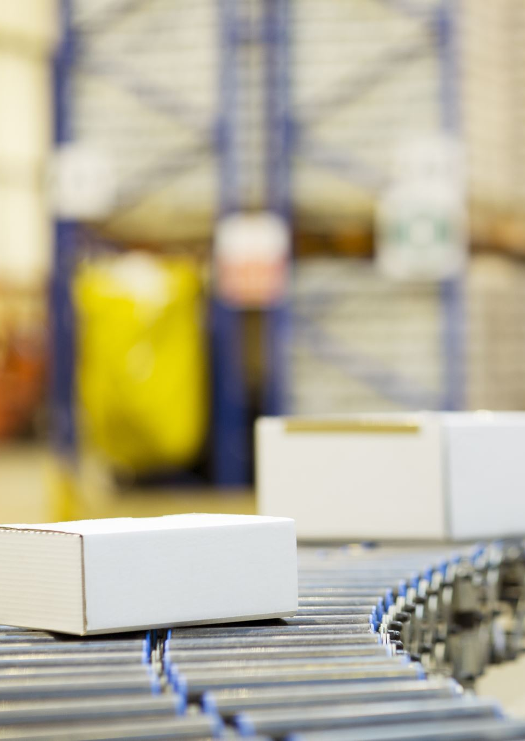
Chewy Thrives Over Logistics-centric Competition
Chewy is set to undertake a robust expansion of its supply chain prowess, utilizing automation within its fulfillment centers to establish cutting-edge warehouse management systems.
Compete against the delivery windows of behemoths like Amazon and Walmart, minimizing the threat of customer migration and bolstering customer retention.
Maintain competitive pricing and direct more funds towards customer acquisition and growth.
Notes:
OKR 1 and 2 for logistics; Ensure that each customer's order is processed, packed, and shipped with greater speed and accuracy.

Slide 10


Pet-parents spend less time on shopping, more time with pets
Employing cutting-edge human centered design principles, Chewy will create an online pet shopping environment that is easily navigable, visually appealing, and highly personalized to every customer journey.
In the envisioned future state, customers will enjoy a hassle-free shopping experience marked by extensive product range, and a highly engaging and user-friendly digital platform.
Notes:
This is meant to hit our OKR 2 (Engagement)

Slide 11


In order to propel Chewy’s transformative impact on pet care, necessary opportunities identified require a large budget of $100 M.
Improve Logistics
Improve Supply Chain and Delivery Speeds
Web Redesign:
Increase Technical Enhancements
Improve Customer Convenience and Access
Low Hanging Fruit:
Improve Value
Increase Partnerships

Slide 12




In order to propel Chewy’s transformative impact on pet care, necessary opportunities identified require a large budget of $100 M.
Increase Customer Satisfaction and Engagement
Increase Customer Retention
Improve Customer Acquisition

Slide 13
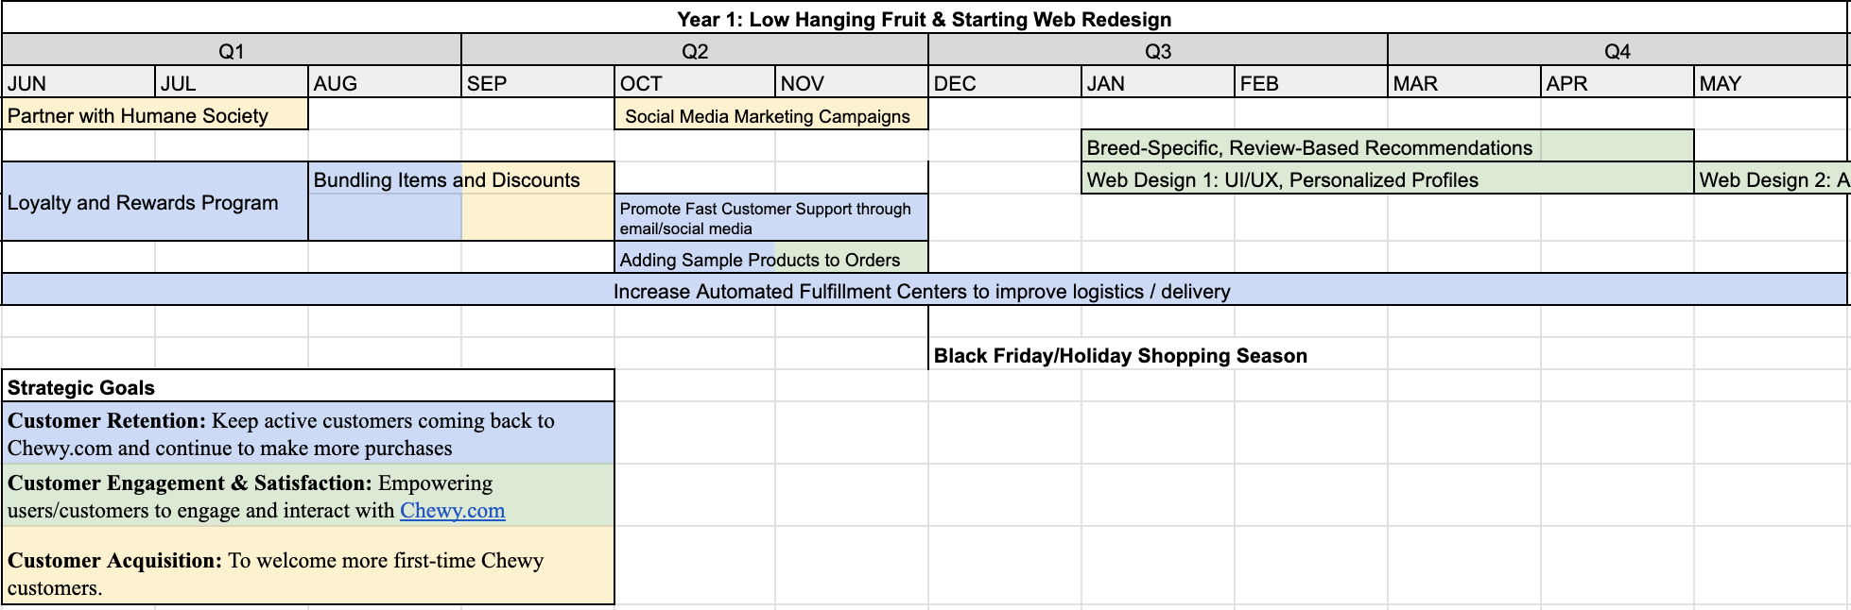
Roadmap Prioritizes Customer Retention, Engagement, and Acquisition to Boost Chewy's relationship with its new and active customers.
Year 1: Focus on attainable improvements before the holiday shopping season while starting major projects (Fulfillment Centers, Web Design)

Slide 14
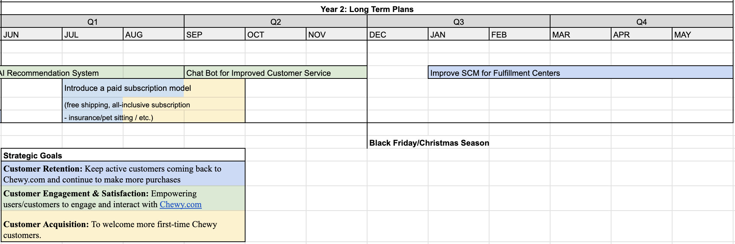
Roadmap Prioritizes Customer Retention, Engagement, and Acquisition to Boost Chewy's relationship with its new and active customers.
Year 2: Focus on major projects (AI, Chat Bot, SCM) to truly push transformative change. MVPs will be used for these projects to lower risk.

Slide 15
Takeaways
Plan to Unleash Pet Parent Delight
Ask: $100M for 2 -year plan
In keen pursuit of:
Leverage: Chewy’s trusted name, product variety, exceptional customer service experience
Challenges: Indirect competition, economic inflation, non-intuitive website
Objectives: Customer retention, engagement, and acquisition
Operational Efficiency
(Customer Rewards, Loyalty Incentives)
Enhanced Product Way-Finding
Reinvigorated Customer Centricity
(UI Makeover)
(SCM & Automation)
Notes:
Jen

